Slide 1
2.Process Management & Synchronization
Introduction of Process Management
Program vs Process
A process is defined as an entity which represents the basic unit of work to be implemented in the system.
A process is a program in execution.
For example, when we write a program in C or C++ and compile it, the compiler creates binary code. The original code and binary code are both programs.
When we actually run the binary code, it becomes a process.
A process is an ‘active’ entity, as opposed to a program, which is considered to be a ‘passive’ entity.
A single program can create many processes when run multiple times; for example, when we open a .exe or binary file multiple times, multiple instances begin (multiple processes are created).

Slide 2
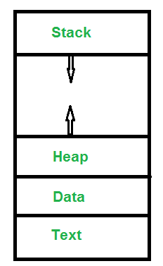
What does a process look like in memory?
When a program is loaded into the memory and it becomes a process,
it can be divided into four sections ─ stack, heap, text and data.
The following image shows a simplified layout of a process inside main
memory −
Text Section:A Process, sometimes known as the Text Section, also includes the current activity represented by the value of the Program Counter. Stack: The Stack contains the temporary data, such as function parameters, returns addresses, and local variables. Data Section: Contains the global variable. Heap Section: Dynamically allocated memory to process during its run time.

Slide 3
A process has following attributes.
The Attributes of the process are used by the Operating System to create the process control block (PCB) for each of them. This is also called context of the process. Attributes which are stored in the PCB are described below.
1. Process ID
2. Program counter
3. Process State
4. Priority
5. General Purpose Registers
6. List of open files
7. List of open devices
OS also maintain the list of all open devices which are used during the execution of the process.

Slide 4
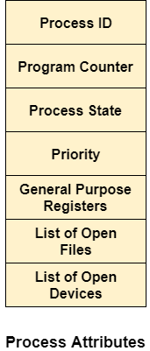
All of the above attributes of a process are also known as thecontext of the process. Every process has its own process control block(PCB), i.e each process will have a unique PCB. All of the above attributes are part of the PCB.

Slide 5
States of Process: A process is in one of the following states:
New: Newly Created Process (or) being-created process.
Ready: After creation process moves to Ready state, i.e. the process is ready for execution.
Run: Currently running process in CPU (only one process at a time can be under execution in a single processor).
Wait (or Block): When a process requests I/O access.
Complete (or Terminated): The process completed its execution.
Suspended Ready: When the ready queue becomes full, some processes are moved to suspended ready state
Suspended Block: When waiting queue becomes full.

Slide 6
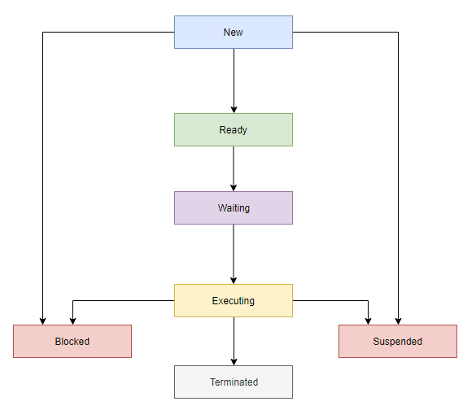
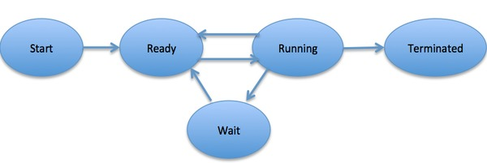

Slide 7
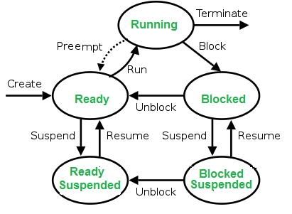

Slide 8
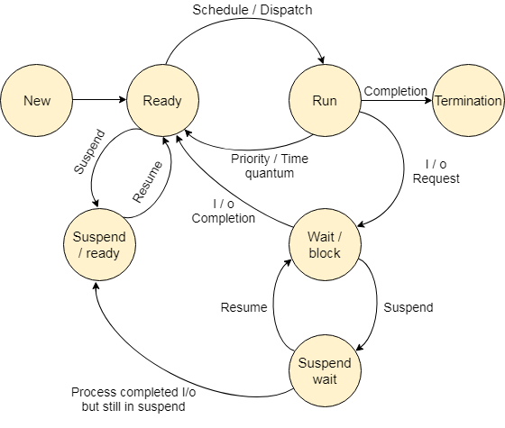

Slide 9
Context Switching The process of saving the context of one process and loading the context of another process is known as Context Switching.
In simple terms, it is like loading and unloading the process from running state to ready state.
Operations on the Process
1. Creation
2. Scheduling
3. Execution
4. Deletion/killing

Slide 10
Job/Process Scheduling
The process scheduling -is the activity of the process manager that handles the removal of the running process from the CPU and the selection of another process on the basis of a particular strategy.
It is also known as job scheduling
Process Scheduling Queues
The OS maintains all PCBs in Process Scheduling Queues. The OS maintains a separate queue for each of the process states and PCBs of all processes in the same execution state are placed in the same queue.
When the state of a process is changed, its PCB is unlinked from its current queue and moved to its new state queue.

Slide 11
The Operating System maintains the following important process scheduling queues −
Job queue − This queue keeps all the processes in the system.
Ready queue − This queue keeps a set of all processes residing in main memory, ready and waiting to execute. A new process is always put in this queue.
Device queues − The processes which are blocked due to unavailability of an I/O device constitute this queue.

Slide 12
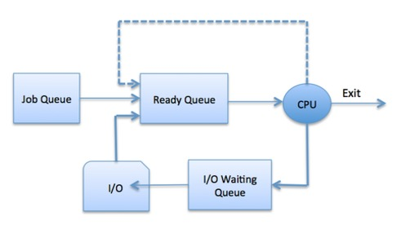

Slide 13
Process Hierarchy
In a computer system, we require to run many processes at a time and some processes need to create other processes while execution.
The child process can also create other processes if required.
This parent-child like structure of processes form a hierarchy, called Process Hierarchy.
In UNIX, a process and all of its children and grandchildren form a process group.
There is no hierarchy system in Windows.
Process model
Two states model
Five states model(seen previously)

Slide 14
Two-State Process Model
Two-state process model refers to running and non-running states −
1.Running
2.Not Running
Schedulers
Schedulers are special system software which handle process scheduling in various ways. Their main task is to select the process/ jobs to be submitted into the system and to decide which process to run.
Schedulers are of three types −
Long-Term Scheduler
Short-Term Scheduler
Medium-Term Scheduler

Slide 15
Long Term Scheduler
It is also called a job scheduler.
A long-term scheduler determines which programs are
admitted to the system for processing.
Short Term Scheduler
It is also called a CPU scheduler.
Its main objective is to increase system performance in
accordance with the chosen set of criteria
Medium Term Scheduler
Medium-term scheduling is a part of swapping.
It removes the processes from the memory. It reduces
the degree of multiprogramming.

Slide 16
Problems of Concurrent Processes
Concurrency -is the execution of the multiple instruction sequences at the same time.
It happens in the operating system when there are several process threads running in parallel.
The running process threads always communicate with each other through shared memory or message passing.
Concurrency results in sharing of resources result in problems like deadlocks and resources starvation.
It helps in coordinating execution of processes, memory allocation and execution scheduling for maximizing throughput.

Slide 17
Advantages of Concurrency :
Running of multiple applications –
Better resource utilization –
Better average response time –
Better performance –
Problems in Concurrency :
Sharing global resources –
Optimal allocation of resources –
Locating programming errors –
Locking the channel –

Slide 18
Issues of Concurrency :
Race conditions – A race condition occurs of the outcome depends on which of several processes gets to a point first.
Blocking – Processes can block waiting for resources. A process could be blocked for long period of time waiting for input from a terminal
Starvation – It occurs when a process does not obtain service to progress.
Deadlock – It occurs when two processes are blocked and hence neither can proceed to execute.

Slide 19
Introduction of Deadlock in Operating System
A process in operating systems uses different resources and uses resources in the following way. 1) Requests a resource 2) Use the resource 2) Releases the resource
Deadlock is a situation where a set of processes are blocked because each process is holding a resource and waiting for another resource acquired by some other process.
Consider an example when two trains are coming toward each other on the same track and there is only one track, none of the trains can move once they are in front of each other.

Slide 20
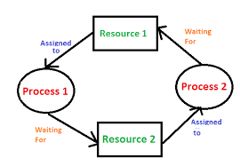
A similar situation occurs in operating systems when there are two or more processes that hold some resources and wait for resources held by other(s). For example, in the below diagram, Process 1 is holding Resource 1 and waiting for resource 2 which is acquired by process 2, and process 2 is waiting for resource 1.

Slide 21
Deadlock can arise if the following four conditions hold simultaneously (Necessary Conditions)
Mutual Exclusion: One or more than one resource are non-shareable (Only one process can use at a time)
Hold and Wait: A process is holding at least one resource and waiting for resources.
No Preemption: A resource cannot be taken from a process unless the process releases the resource.
Circular Wait: A set of processes are waiting for each other in circular form.

Slide 22
Methods for handling deadlock There are three ways to handle deadlock
1) Deadlock prevention or avoidance: The idea is to not let the system into a deadlock state.
2) Deadlock detection and recovery: Let deadlock occur, then do preemption to handle it once occurred.
3) Ignore the problem altogether: If deadlock is very rare, then let it happen and reboot the system. This is the approach that both Windows and UNIX take.

Slide 23
Device Management
An Operating System manages device communication via their respective drivers.
It does the following activities for device management −
Keeps tracks of all devices. Program responsible for this task is known as the I/O controller.
Decides which process gets the device when and for how much time.
Allocates the device in the efficient way.
De-allocates devices.

Slide 24
One of the important jobs of an Operating System is to manage various I/O devices including mouse, keyboards, touch pad, disk drives, display adapters, USB devices, Bit-mapped screen, LED, Analog-to-digital converter, On/off switch, network connections, audio I/O, printers etc.
An I/O system is required to take an application I/O request and send it to the physical device, then take whatever response comes back from the device and send it to the application. I/O devices can be divided into two categories −
Block devices − A block device is one with which the driver communicates by sending entire blocks of data. For example, Hard disks, USB cameras, Disk-On-Key etc.
Character devices − A character device is one with which the driver communicates by sending and receiving single characters (bytes, octets). For example, serial ports, parallel ports, sounds cards etc

Slide 25
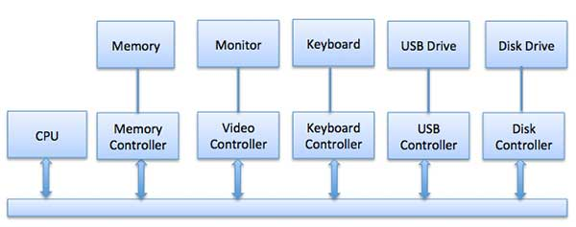
Device Controllers
Device drivers are software modules that can be plugged into an OS to handle a particular device. Operating System takes help from device drivers to handle all I/O devices.
The Device Controller works like an interface between a device and a device driver. I/O units (Keyboard, mouse, printer, etc.) typically consist of a mechanical component and an electronic component where electronic component is called the device controller.

Slide 26
Synchronous vs asynchronous I/O
Synchronous I/O − In this scheme CPU execution waits while I/O proceeds
Asynchronous I/O − I/O proceeds concurrently with CPU execution
Communication to I/O Devices
The CPU must have a way to pass information to and from an I/O device. There are three approaches available to communicate with the CPU and Device.
Special Instruction I/O
Memory-mapped I/O
Direct memory access (DMA)

Slide 27
File Management
File management is one of the basic and important features of operating system.
Operating system is used to manage files of computer system.
All the files with different extensions are managed by operating system.
A file is collection of specific information stored in the memory of computer system.
File management is defined as the process of manipulating files in computer system, it management includes the process of creating, modifying and deleting the files.

Slide 28
The following are some of the tasks performed by file management of operating system of any computer system:
It helps to create new files in computer system and placing them at the specific locations.
It helps in easily and quickly locating these files in computer system.
It makes the process of sharing of the files among different users very easy and user friendly.
It helps to stores the files in separate folders known as directories. These directories help users to search file quickly or to manage the files according to their types or uses.
It helps the user to modify the data of files or to modify the name of the file in the directories.

Slide 29
A file system is normally organized into directories for easy navigation and usage. These directories may contain files and other directions.
An Operating System does the following activities for file management −
Keeps track of information, location, uses, status etc. The collective facilities are often known as file system.
Decides who gets the resources.
Allocates the resources.
De-allocates the resources.

Slide 30
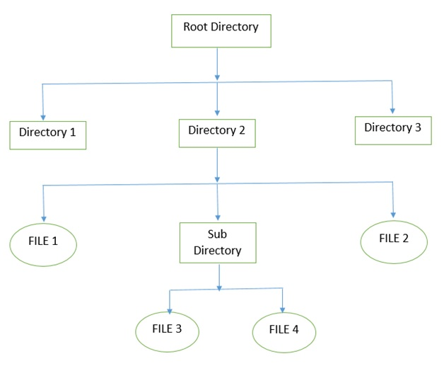

Slide 31
The file management of function in operating system (OS) is based on the following concepts:
File Attributes It specifies the characteristics of the files such as type, date of last modification, size, location on disk etc. file attributes help the user to understand the value and location of files. File attributes is one most important feature. It is uses to describe all the information regarding particular file.
File Operations It specifies the task that can be performed on a file such as opening and closing of file.
File Access permission It specifies the access permissions related to a file such as read and write.
File Systems It specifies the logical method of file storage in a computer system. Some of the commonly used files systems include FAT and NTFS.

